Slide 1
Classes and Objects

Slide 2
Class
It is a template or blueprint from which objects are created. It is a logical entity. It can't be physical.
A class in Java can contain:
Fields
Methods
Constructors
Blocks
Nested class and interface
class <class_name>
{
field;
method;
}

Slide 3
Object
An object in Java is the physical as well as a logical entity, whereas, a class in Java is a logical entity only.
An entity that has state and behavior is known as an object e.g., chair, bike, marker, pen, table, car, etc.
The new keyword is used to allocate memory at runtime. All objects get memory in Heap memory area.
Objects has 3 characteristics
State: represents the data (value) of an object.
Behavior: represents the behavior (functionality) of an object such as deposit, withdraw, etc.
Identity: An object identity is typically implemented via a unique ID. The value of the ID is not visible to the external user. However, it is used internally by the JVM to identify each object uniquely.

Slide 4
An object is an instance of a class. A class is a template or blueprint from which objects are created. So, an object is the instance(result) of a class.
An object is a real-world entity.
An object is a runtime entity.
The object is an entity which has state and behavior.
The object is an instance of a class.

Slide 5
Method in Java
In Java, a method is like a function which is used to expose the behavior of an object.
Advantage of Method
Code Reusability
Code Optimization
The new keyword is used to allocate memory at runtime. All objects get memory in Heap memory area.
See Example programs

Slide 6
Access Modifiers in Java

Slide 7
Private: The access level of a private modifier is only within the class. It cannot be accessed from outside the class.
Default: The access level of a default modifier is only within the package. It cannot be accessed from outside the package. If you do not specify any access level, it will be the default.
Protected: The access level of a protected modifier is within the package and outside the package through child class. If you do not make the child class, it cannot be accessed from outside the package.
Public: The access level of a public modifier is everywhere. It can be accessed from within the class, outside the class, within the package and outside the package.

Slide 8
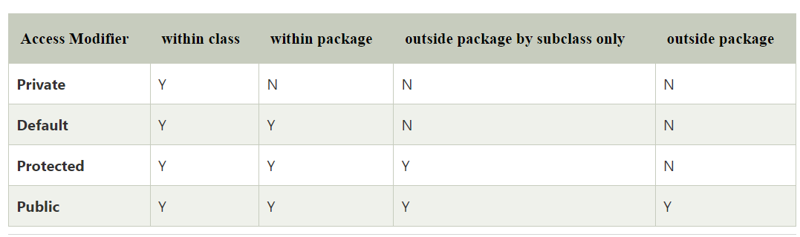

Slide 9
A class cannot be private or protected except nested class.
The default modifier is accessible only within package. It cannot be accessed from outside the package. It provides more accessibility than private. But, it is more restrictive than protected, and public.
The protected access modifier is accessible within package and outside the package but through inheritance only.
The protected access modifier can be applied on the data member, method and constructor. It can't be applied on the class.
It provides more accessibility than the default modifer.

Slide 10
Note- :default keyword

Slide 11
The default keyword is used in interface methods to provide a concrete implementation, avoiding the need for all implementing classes to override the method.
we cannot use the default keyword for data members (fields). The default keyword is only applicable to methods inside interfaces, not to fields.

Slide 12
Encapsulation
Encapsulation in Java is a process of wrapping code and data together into a single unit.
We can create a fully encapsulated class in Java by making all the data members of the class private. Now we can use setter and getter methods to set and get the data in it.

Slide 13
Advantages of encapsulation
It provides you the control over the data
it is a way to achieve data hiding in Java because other class will not be able to access the data through the private data members.
The encapsulate class is easy to test. So, it is better for unit testing.
The standard IDE's are providing the facility to generate the getters and setters. So, it is easy and fast to create an encapsulated class in Java.

Slide 14
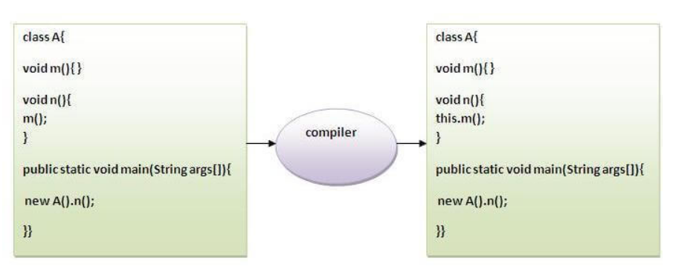
Use of “this” keyword
this: to refer current class instance variable
The this keyword can be used to refer current class instance variable. If there is ambiguity between the instance variables and parameters, this keyword resolves the problem of ambiguity.
this: to invoke current class method

Slide 15
Static method
If you apply static keyword with any method, it is known as static method.
A static method belongs to the class rather than the object of a class.
A static method can be invoked without the need for creating an instance of a class.
A static method can access static data member and can change the value of it.

Slide 16
Static block
Static blocks are executed once, when the class is loaded into memory by the JVM.
If there are multiple static blocks in a class, they are executed in the order in which they are defined.
Static blocks cannot access non-static variables or methods because they belong to the class and not to any instance.

Slide 17
Constructors (5 Most relevant Points)
A constructor in is a block of code that initializes (constructs) the state and value during object creation.
It is called every time an object with the help of a new () keyword is created.
Even if you haven’t specified any constructor in the code, the Java compiler calls a default constructor. The default constructor is used to assign default states and values, such as 0, null, etc., to the object. The general syntax of a constructor is:
class ClassName{
ClassName(){ //creating a constructor
}
}

Slide 18
A constructor is syntactically similar to a method, but there are several differences between the two.
Firstly, although it returns the current class instance, a constructor does not have any explicit return type.
Secondly, it is invoked implicitly, whereas a method is not..
constructors do not explicitly return a value in the way functions or methods do, they implicitly return the instance of the class they are constructing

Slide 19
Rules for constructor creation
The constructor’s and class’s name must be identical
You cannot define an explicit return value to a constructor
A constructor cannot be any of these: static, synchronized, abstract, or final
One thing to note here is that you can have a public, private, or protected constructor in Java by using access modifiers that control object creation.
Types of constructors: default, no-arg,parameterized

Slide 20
Whenever we use new keyword to create an instance of a class, the constructor is invoked and the object of the class is returned.
Since constructor can only return the object to class, it’s implicitly done by java runtime and we are not supposed to add a return type to it.
Default constructor is always without argument and provided by java compiler only when there is no existing constructor defined.

Slide 21
if we write a constructor with no arguments, the compiler does not create a default constructor

Slide 22
Constructor Overloading (Very Important)
Constructor overloading in Java is a technique of having more than one constructor with different parameter lists.
They are arranged in a way that each constructor performs a different task.
They are differentiated by the compiler by the number of parameters in the list and their types.
Account(int a);
Account (int a,int b);
Account (String a,int b);

Slide 23

Wrapper Classes in Java
wrapper classes are used to convert primitive data types into objects. Each primitive type has a corresponding wrapper class in the java.lang package.

Slide 24
Example of Wrapper classes
int -> Integer
double -> Double
char -> Character
boolean -> Boolean
These classes "wrap" primitive values into objects, which allows primitives to be used in places where objects are required, such as in collections (like ArrayList, HashMap, etc.).

Slide 25
Why do we need Wrapper classes?
Collections: Java's collections (ArrayList, HashSet, etc.) only store objects, not primitives.
Utility Methods: Wrapper classes provide useful methods (e.g., Integer.parseInt()).
Synchronization: Objects are needed for multithreading and synchronization.
Autoboxing & Unboxing: Java automatically converts between primitive types and their wrapper classes.

Slide 26
Q:Can constructor be private????
Do one either Singleton or Factory x program

Slide 27
Yes!!!!
A private constructor is mainly used to restrict instantiation of a class from outside the class itself. This is useful in scenarios such as:
Singleton Design Pattern - Ensures only one instance of a class exists.
Factory Methods - Controlling instance creation via static methods.
Utility Classes - Preventing instantiation of classes that contain only static methods. (Will be discussed In exception Handling)

Slide 28
Singleton Design Pattern: Only one instance is created even if we call getInstance() multiple times.
Factory Method Program: The constructor is private, and object creation is controlled via a static factory method.
Definition of Factory Method: is a design pattern used to create objects without exposing the instantiation logic to the client. Instead of using new a static method is used to create and return instances.

